Slide 1

Financial health
Unit 5
BU7313 Financial Modelling & Scenario Analysis
Prof Gerhard Kling University of Aberdeen

Slide 2
AGENDA: Unit 5
Optimal capital structure
Irrelevance theorem
Limitations of the MM model
Positive theories of capital structure
Measures of financial health
Financial leverage
Interest coverage
Credit ratings and CDS
Corporate cash holding
Excess cash
Motives of cash holding
Working capital management
Practical considerations
Assessment of tax shields
Optimal levels of debt
Case study

Slide 3
Contents
Optimal capital structure
Measures of financial health
Corporate cash holding
Practical considerations

Slide 4
Capital structure theory
Capital Structure: How a firm finances its operating assets: equity (E) or debt (D)
Difference between debt and equity
Equity: residual claim
Debt: contractual payment
Implications for risk: debt holders are risk averse even in a risk neutral setting
Modigliani-Miller Theorem: The Irrelevance Theorem
Uses a simple model of valuation
No arbitrage –i.e., equal rates of return for equal risks.
Risk-free debt
Under certain assumptions (perfect markets, no taxes or bankruptcy costs, no asymmetric information, etc.), the value of the firm (V) is independent of how the firm is financed.
V = D + E

Slide 5
Main shortcomings of MM theory
MM ignores agency costs – incentives to maximise value
Literature also stresses the tax advantage of debt which affects capital structure
Cliental effects – intermediaries prefer certain securities due to regulation, which also affects capital structure, also enforcement of contracts matters
Hence, corporate governance matters and country-specific circumstances (bank based versus market based system)
Above all, MM does not allow growth (this point has been overlooked in the literature!)

Slide 6
The ‘No-growth assumption’
Condition for optimal investment: “where the marginal yield on physical assets is equal to the market of interest” (p. 262)
Once this condition is met, there is no incentive to invest: steady state condition
This follows from the equivalence under certainty of maximising profits and market value
Note: net profit refers to net income (residual claim of equity holders) – equity cash flows
P. 264 only if the investment increases the market value of the firm’s shares, it is worth undertaking – maximisation of shareholder value
MY QUESTION: IF A FIRM DOES NOT GROW, INVESTMENT IS NOT NEEDED; SO WHY DOES A FIRM REQUIRE DEBT OR EQUITY?
The problem is: once a firm grows conditional on access to finance, models get very complex!

Slide 7
Uncertainty in the MM model
MM use risk discounts or risk premium – risk adjusted or certainty equivalent (you price risk into the return so it becomes again a one dimensional problem)
Using utility functions (Von Neuman-Morgenstern)
Neumann, John von and Morgenstern, Oskar Theory of Games and Economic Behavior. Princeton, NJ. Princeton University Press. 1944, sec.ed. 1947, th.ed. 1953.
Problem: outcomes are subjective due to subjective risk preferences
Avoid this problem through market prices, as they reflect preferences of all potential owners – so it is no longer subjective
Average profit per unit of time follows a (subjective) probability distribution (p. 265)
Assume that expected return is objective (investors are in agreement – otherwise you get biased estimates)
Density function is not specified

Slide 8
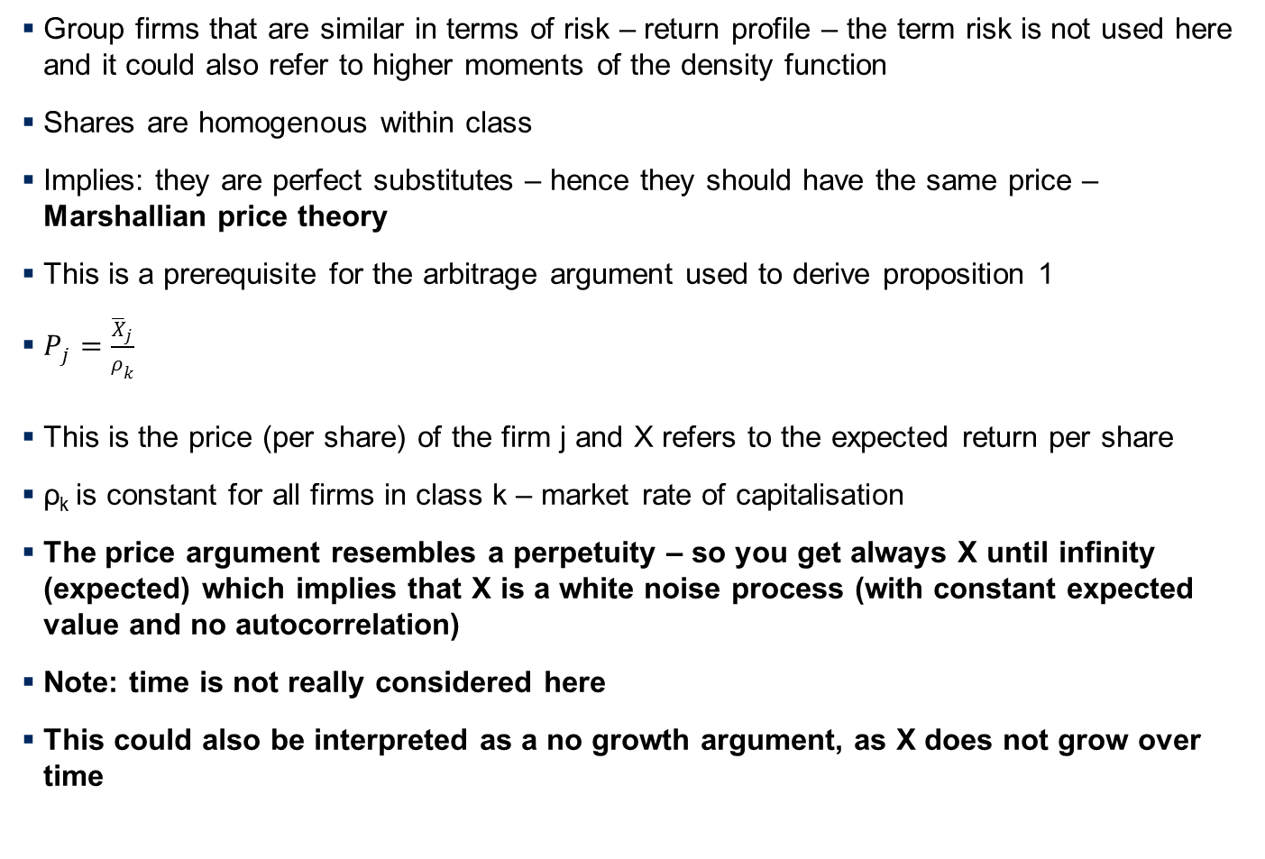
Equivalent return classes

Slide 9
Marshallian analysis
Prices of all other goods are given – price taker behaviour – we use similar argument for cost-income ratio
Distribution effect – no distinction between dividends and retained earnings (p. 266)
See below: dividend policy and share buybacks are irrelevant

Slide 10
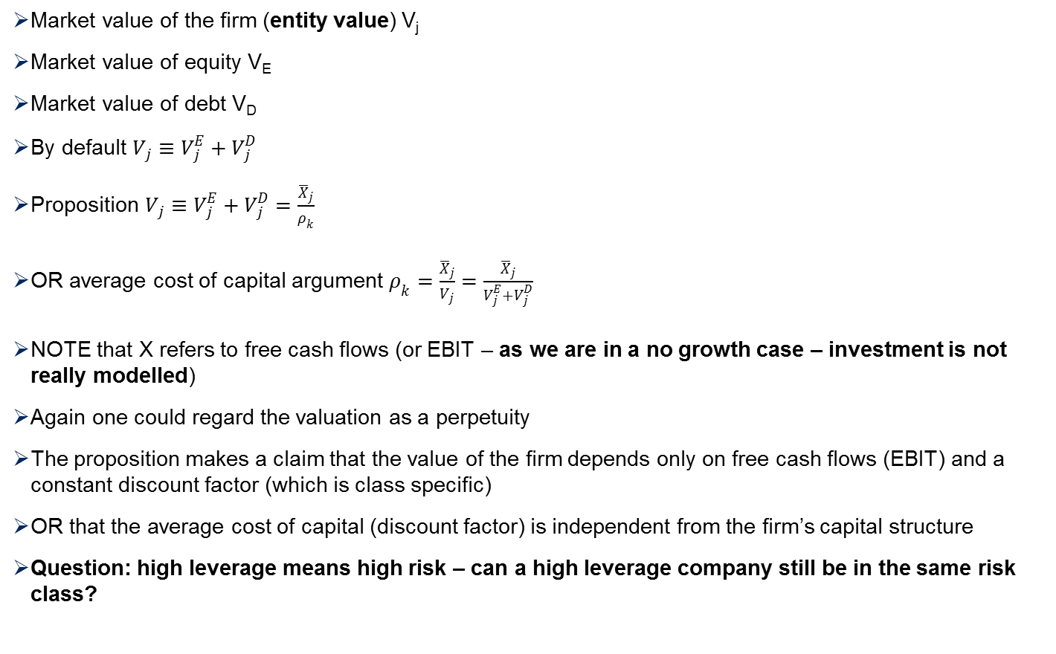
Proposition 1

Slide 11
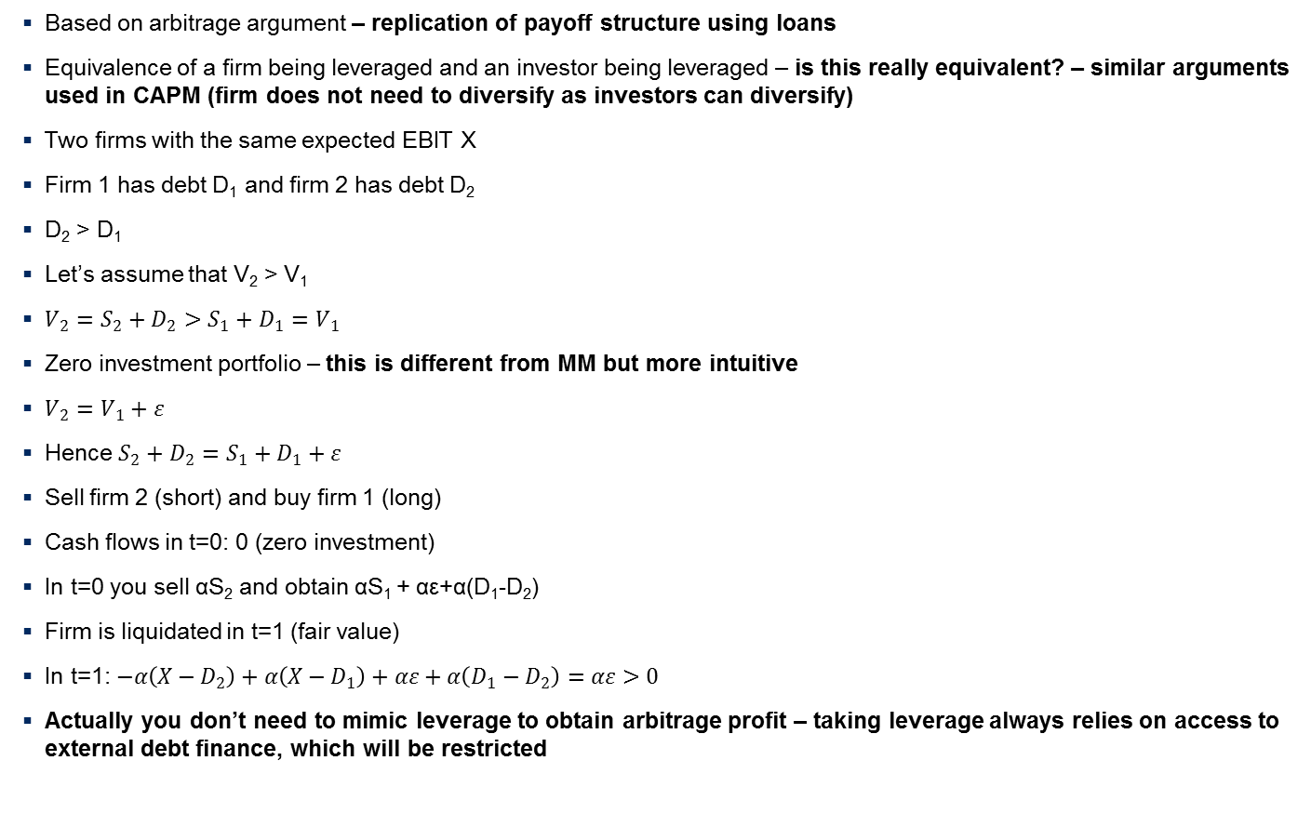
Proof of Proposition 1

Slide 12
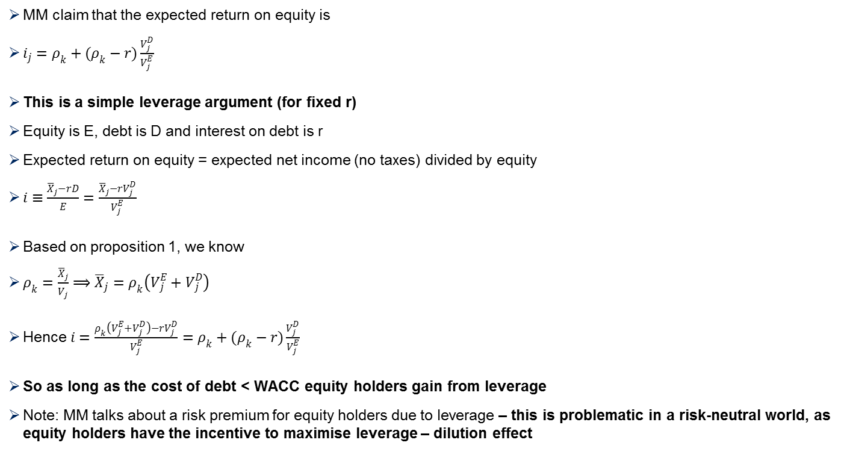
Proposition 2

Slide 13
Violation of MM assumptions
That is, there is no “optimal” capital structure, as capital structure does not affect firm value (see Proposition 1)
However, if MM’s assumptions are violated, capital structure matters
Usual violations
Traditional finance: bankruptcy costs, agency costs, taxes, asymmetric information
Behavioral finance: inefficient markets, managerial and investor behaviour
So what is the “optimal” capital structure if market frictions exist?

Slide 14
Positive Theories of Capital Structure (1/2)
I. Trade-off Theory
This theory can be obtained from different perspectives. Debt is inherently risks (as it leads to default risk)
Again consider payoff structure of debt and equity holders in a risk-neutral setting
We need to introduce frictions to make the argument work:
Bankruptcy costs exist. There is a “tax-bankruptcy” trade-off for debt
Tax benefit versus bankruptcy cost
There is an II. Agency perspective:
Debt disciplines manager and mitigates agency problems of free cash flows (see Jensen’s (1986) Free Cash Flow Hypothesis), since debt must be repaid to avoid bankruptcy
Yet, this argument makes shareholder-debt holder conflicts worse
Problem: managers might have an incentive to gamble
References: Jensen and Meckling (1976), Jensen (1986) and Hart and Moore (1994)

Slide 15
Positive Theories of Capital Structure (2/2)
The III. Stakeholder co-investment perspective:
Some firms efficiency requires a firm’s stakeholders to make significant firm-specific investments. Firms making unique products will lose customers if they go bankrupt
Reference: Titman (1984), Maksimovi and Titman (1991).
Note: These perspectives differ from the “tax-bankruptcy” tradeoff. The costs of debt are from disruption to normal business operations and do not depend on the arguably small direct costs of bankruptcy
More perspectives include human capital theory (CEO’s reputation) used in organization studies and management research

Slide 16
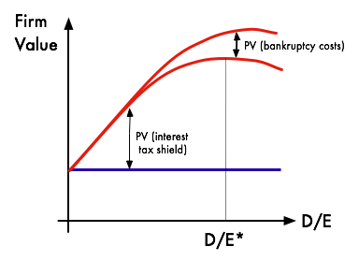
The three perspectives result in the following
Marginal benefit of debt declines as debt increases. Hence, there is an optimal capital structure

Slide 17
Pecking Order Theory
Asymmetric information exists and it is costly. Managers have more information about the quality of the firm or projects
Companies select financing according to the law of least effort
(1) Internal financing (retained earnings)
(2) Bank debt (in different levels, easiest: bank debt)
(3) Equity
Adverse selection issues: Equity has a lot, debt a little, retained earnings none => the choice of financing is a signal to the market (signaling theories in game theory)
Myers (1984): when equity is issued, investors think firm is overvalued (managers use the last resort tool, only because firm is overvalued). Investors demand a higher return on equity than on debt
References: Donaldson (1961), Myers (1984)

Slide 18
Market Timing Theory
Firms are indifferent between equity or debt financing. But the market makes pricing mistakes from time to time
Managers select the debt or equity according to the relative mispricing. If neither market looks favorable, manager may defer issuances. If conditions look unusually favorable, managers may raise funds even if the firm has no need for funds
There are no firm specific variables (“factors”) that influence D/E
Behavioral finance-type explanation
Baker and Wrugler (2002): Theory explains “hot” and “cold” IPO periods
Also related to M&A literature and equity issues in the context of future acquisitions

Slide 19
Managerial Inertia Model
Firms do not act to adjust capital structure
When stock prices are high, firms have low D/E
When stock prices are low, firm have high D/E
There is no counter action to counterbalance stock return induced D/E changes
Welch (2004) finds that stock returns can explain D/E dynamics
Issues
Mostly an empirical argument
So empirical finding led to a theory
It depends how leverage is calculated: market value based or book value based; both is used in the empirical literature
By construction, a market value based definition will be sensitive to changes in share price
BUT: this does not prove the theory; it is just based on the way leverage is measured

Slide 20
Stylized facts based on prior research
Firms use debt financing too conservatively – Graham (2000), Strebulaev and Yang (2007)
Negative relation between profitability and leverage - Myers (1993), Myers and Shyam-Sunder (1999)
Firms mean-revert slowly towards target leverage – Fama and French (2002), Flannery and Rangan (2006).
Changes in market leverage are largely explained by changes in equity prices -Welch (2004)
Leverage largely driven by unexplained firm-specific fixed effect - Lemmon, Roberts, Zender (JF, 2006).
Link between governance mechanisms and leverage ambiguous - Berger, Ofek & Yermack (JF, 1997), John and Litov (2008)

Slide 21
Contents
Optimal capital structure
Measures of financial health
Corporate cash holding
Practical considerations

Slide 22
What is financial health?
Main question: is the level of debt sustainable?
When using DCF models, it is good practice to check predicted levels of debt
Does debt increase quickly?
Does debt accumulate faster than equity?
Differences between small and medium-sized enterprises (SMEs) and larger corporations
Limited access to external finance
Credit rationing due to information asymmetry etc.
Rolling debt over is limited in SMEs; repayment of debt in a certain period
Use of collaterals
Ratings and CDS
CDS only available for large corporations

Slide 23
Common measures of financial health
Financial leverage can be defined in different ways
Total debt divided by total equity
Total debt includes short and long-term debt
Adjustments might be needed for off-balance sheet items and debt equivalents
Interest coverage defined as EBIT / Interest expenses
Usually a ratio of 4 or higher is considered safe
Interest coverage is a useful measure to assess the risk of liquidity defaults
Different types of default
Insolvency default: liabilities exceed assets
Liquidity default: interest / principal cannot be paid (most common due to a lack of access to finance)

Slide 24
Contents
Optimal capital structure
Measures of financial health
Corporate cash holding
Practical considerations

Slide 25
Cash holding, access to short-term finance and liquidty
What do we observe?
Companies tend to have negative debt due to high cash holding
I refer to Kling et al. (2014)
Based on a sample of UK listed companies, we observe a significant increase of cash holding from 6 to 11% since 1988
How can we explain it?
Recently, prior research has argued that the increase in cash holding is due to corporate governance problems (Denis and McConnell, 2003)
Motives for cash holding: (1) transaction, (2) prevention, (3) investment opportunities, and (4) self-interest
What is our contribution?
Relationship between cash holding, access to short-term debt and trade credit
Common believe: trade credit is not important (discussed in Tirole (2006: 96))
But: trade credit accounts for 39% of short-term finance (UK companies in 2009)

Slide 26
Cash holding of UK companies has increased since 1988
Cash holding in percent of total assets, 1988-2008

Slide 27
Increase in cash holding is driven by “excess cash”
Cash holding and excess cash* in percent of total debt, 1988 - 2008
* Excess cash = cash holding – operating cash; operating cash = 2% of revenues

Slide 28
What drives cash holding?
Bankruptcy costs imply that managers try to avoid cash shortage
Signalling
Prevention
Transactions
Need cash to run operations (e.g. wages)
Operating cash = 2% of revenues
“You do not want to go to bank every day”
Investment opportunities
Cash holding
Growth opportunities (emerging markets, new products)
Information asymmetry between managers and investors
Free cash flow hypothesis (Jensen, 1986)
Stockpiling of cash
Empire building: investment in value-destroying projects (e.g. M&A)
Self-interest

Slide 29
Contents
Optimal capital structure
Measures of financial health
Corporate cash holding
Practical considerations

Slide 30

Andersons Inc. – finding the right capital structure
Steps to derive the optimal capital structure
Look at earnings before interest and taxes (EBIT) over time
Compare EBIT and interest expenses
Derive interest coverage = EBIT/interest expenses – liquidity measured used by rating agencies
Determine critical level of interest coverage needed to avoid drop in credit rating
Derive debt level based on current pre-tax cost of debt that matches the required interest coverage
Allow a buffer if things go wrong!
Determine impact of new capital structure on share price

Slide 31
Interest coverage increased
Interest coverage = EBIT / Interest expenses, 2004-2007
Source: Nasdaq.com, annual reports, own calculations see Excel file on Blackboard

Slide 32
Deriving the maximum debt level compared to 2007
What to do?
Use interest coverage of 4.3
Based on 10K report 2007, pre-tax cost of debt was 5.45% in 2007
Calculate maximum interest expense = $125 million (EBIT) / 4.3 = $29 million
This leads to the maximum debt level = $29 million / 5.45% = $528 million
The current level of debt in 2007 is $181 million
→Increase debt by $346 million
But consider a “safety net”

Slide 33
How does a change in capital structure affect value?
Change in cost of capital (WACC)
Unlikely – even a risk that WACC increases due to change in credit rating
Debt imposes financial discipline based on agency theory
But could also lead to gambling – no downside!
Tax benefits of higher interest expenses
Could be a real benefit
Use the adjusted present value method (APV) – not discussed in this course
Get a rough calculation of tax benefits

Slide 34
Calculation of tax benefits and its impact on value
Current market value
Share price = $43.44 and number of shares = 18086000
Hence, market value = $786 million
Tax rate (see 10K report): 35%
Cost of debt = 5.45%
New debt = $346 million
Increase in interest expense = 5.45%* $346 million = $18.9 million
Tax shield = 35%*$18.9 million = $6.6 million
Discount rate should be unlevered cost of equity assume 10%
Value of tax benefit = $6.6 million/10% = $66 million
Impact on value 8.4% - hence share price should go up = $47.09

Slide 35
What did actually happen?
Debt increased by $402 million – more than what we would recommend
This would imply an interest coverage of 3.0
Far below historical levels
Risky strategy
Might cause a decline in credit rating, which would increase cost of capital
Our calculation only works if we consider moderate changes of capital structure that do not affect credit rating
If the credit rating changes, the calculation has to consider high cost of capital
Risking a downgrading is usually not worth it!

Slide 36
MAIN INSIGHTS
Theories of capital structure
Limitations of the MM model
Positive theories of capital structure
Measures of financial heath
Financial leverage
Interest coverage
Corporate cash holding
High cash holding due to limited access to short-term finance
Some companies in negative debt
Practical issues
Determine tax shields
Derive maximum level of debt

